Slide 1
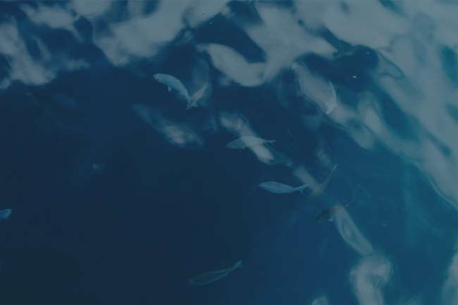

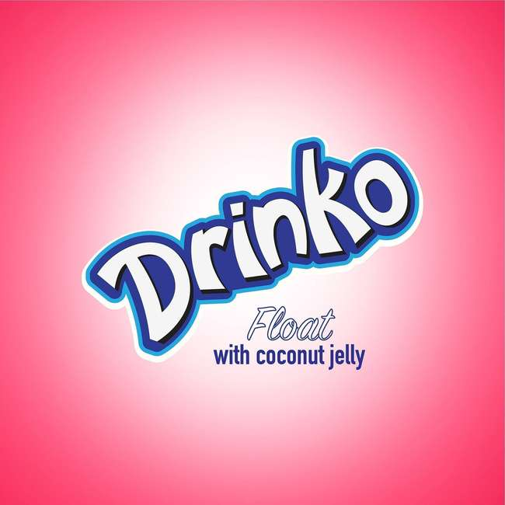
DRINK IT!
BITE IT!
EXPERIENCE IT

Slide 2

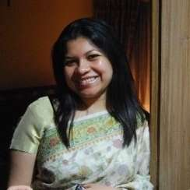
Prepared For
Ms.Tilka Farzana (TFZ)
Lecturer,
Department of Marketing and International Business
North South University
Prepared By
ID
Mehbub Hasan Khan
2132221630

Slide 3

Content
INTRODUCTION
STP STRATEGIES
MARKETING MIX
PRODUCT
PRICE
PLACE
PROMOTION
PRODUCT LIFE CYCLE
CONCLUSION

Slide 4
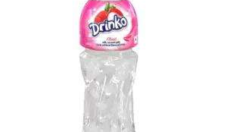
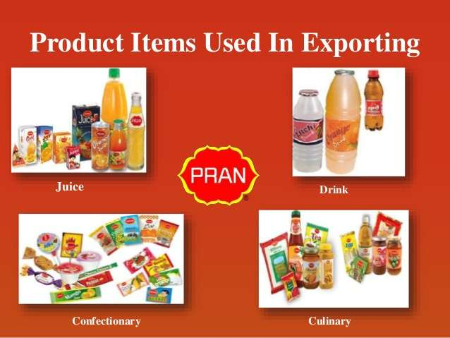
INTRODUCTION

Slide 5
Largest Food Producer In Bangladesh
Inception: 1980
Founder: Major General Amzad Khan Chowdhury
PRAN stands for: Program For Rural Advancement Nationality
Exports products:106 countries
Product Categories: 10
Total Products: Around 200
Total employees: 30,000+
PRAN

Slide 6
Mission
"Poverty & hunger are curses. Our aim is to generate employment and earn dignity and self respect for our compatriots through profitable enterprises."
Vision
"Improving livelihood. "
Objectives
"Innovate new products, try to fulfill public demand, give full customer satisfaction, distribute product all over the country, set a reasonable price."

Slide 7
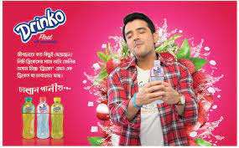
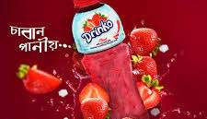
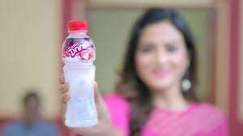
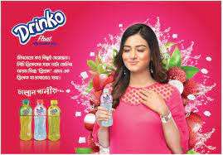
STP STRATEGIES

Slide 8

STP STRATEGIES
CONSUMER SEGMENTS
Target Market Strategies
Demographic Segments
Geographic Segments
Mass marketing
Age 12-35 years old
Broadly marketed,
Reach wide audience as per their needs
Cities , Asian Regions
Value Proposition
More for less
Reasonable at price but great quality and tasty

Slide 9
4Ps Marketing Mix Powerpoint
Product
PRICE
01
4 p’s
02
04
03
PROMOTION
PLACE

Slide 10
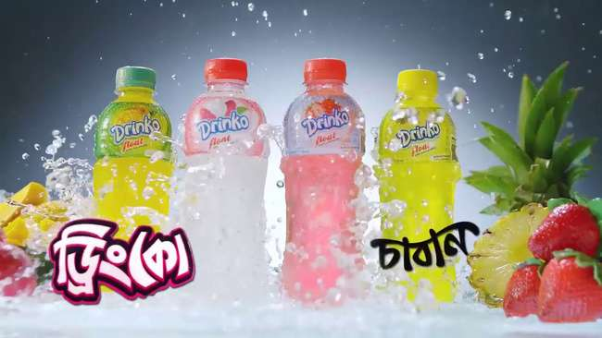
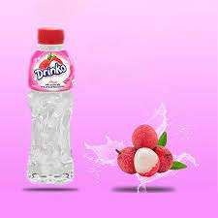
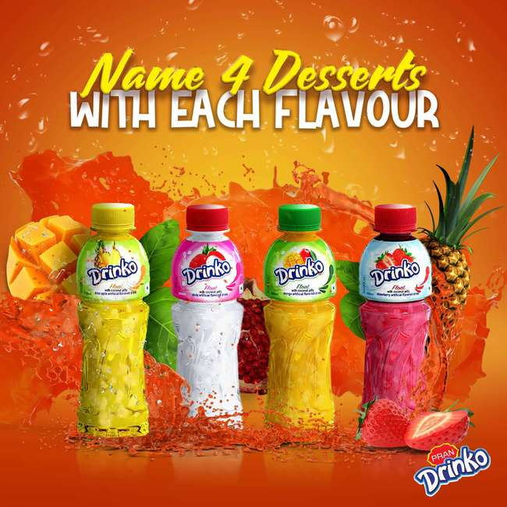
PRODUCT

Slide 11
PRODUCT
THREE LEVELS OF PRODUCT
Core benefit - Chewable drink, Flavoured drink
Actual product- Pran Drinko
Augmented product-Additional customer needs and service

Slide 12
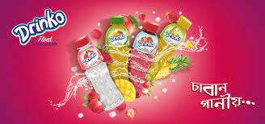
PRODUCT
THREE LEVELS OF PRODUCT
PRODUCT AND SERVICE DECISIONS:
Individual product - drink type beverage, HDPE packaging , simple tag, 250 ml
Product line- Line filling
Product mix- Line depth

Slide 13
PRODUCT
Branding Strategy:
Brand positioning -Least effective and competitors can easily copy
Brand name and selection - Chewable fruit drink
Brand sponsorship - Manufacturer brand
Brand development - Line extension

Slide 14
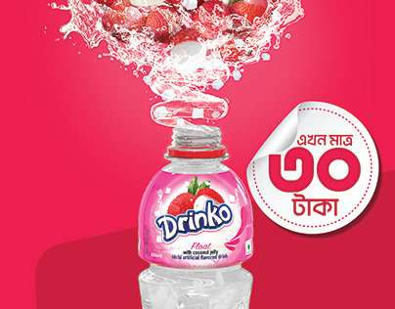
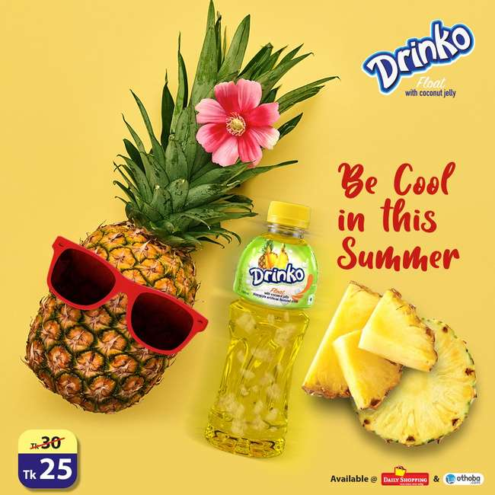
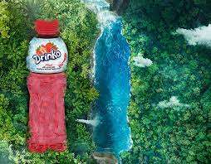
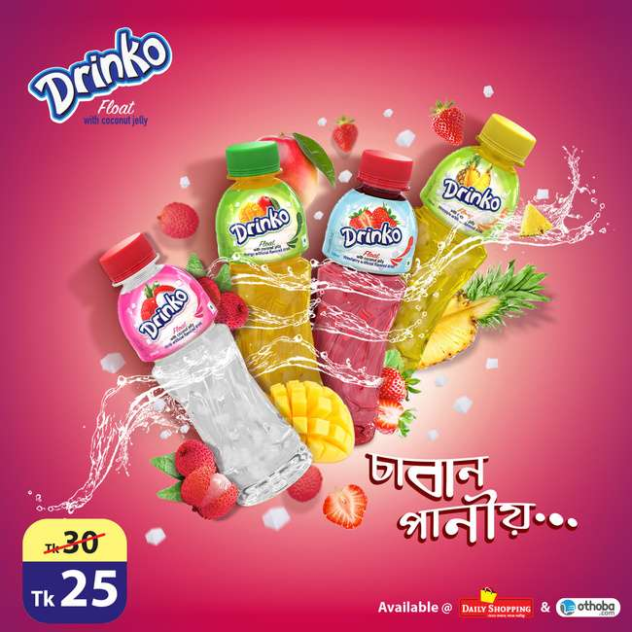
PRICE

Slide 15
PRICE
TYPE OF PRICE
PRICES
INTERNAL & EXTERNAL FACTORS
Cost-based pricing
-Fixed Cost
-Variable Cost
-Total Cost
Price Ceiling:BDT.40
MarketPrice : BDT.30
Price Floor:BDT.20
Market & Demands Competition
Economic Condition

Slide 16

PRICE
NEW PRODUCT PRICING STRATEGY:
Market Penetration
PRODUCT MIX PRICING STRATEGY:
Product Line Pricing
Price Adjustment Strategy:
Dynamic Pricing

Slide 17
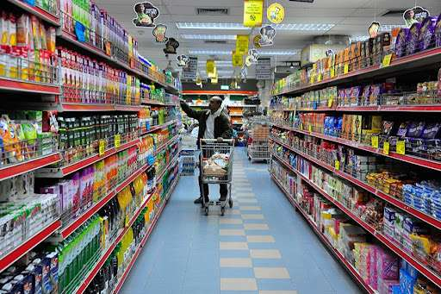
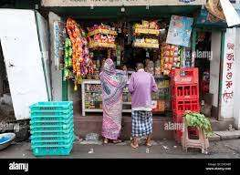
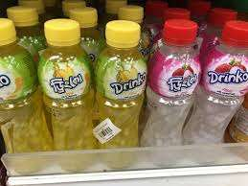
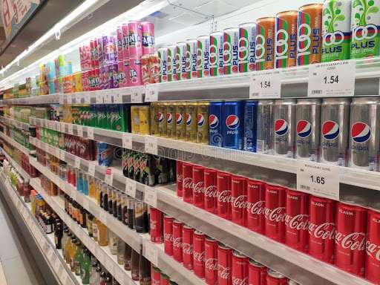
PLACE

Slide 18

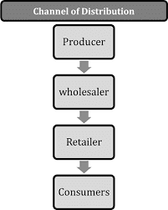
PLACE
CHANNEL LEVEL-INDIRECT MARKETING CHANNEL
PRODUCER
WHOLESALER
RETAILER
FINAL BUYER/CONSUMERS

Slide 19

PLACE
ONLINE MARKETING
ONLINE RETAILER
ONLINE SHOPS
DISTRIBUTION CHANNEL- CONVENTIONAL DISTRIBUTION CHANNEL
INDEPENDENT PRODUCERS,WHOLESALERS,RETAILERS
SEPARATE BUSINESS CHANNEL
MARKET PENETRATION:
SHELF SPACE TECHNIQUE
AVAILABILITY IN MAJOR DISCRICTS
AVAILABLE MOSTLY IN LOCAL SHOPS AND SUPERSTORES

Slide 20
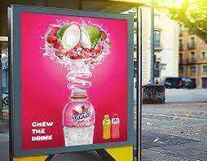
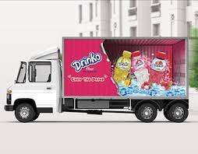
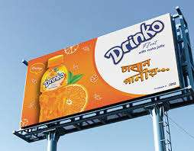
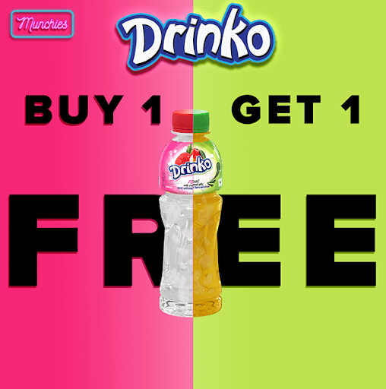
PROMOTION

Slide 21

PROMOTION
DESIGNING PROMOTION MASSAGE:
BUDGETING METHOD FOR PROMOTION:
PROMOTION MIX STRATEGIES:
TARGET AUDIENCE:
Teenagers
Younger adults
Massage content
Massage structure
Massage format
Affordable Method
Objective and task method
Advertising
Sales Promotion
Public relations

Slide 22

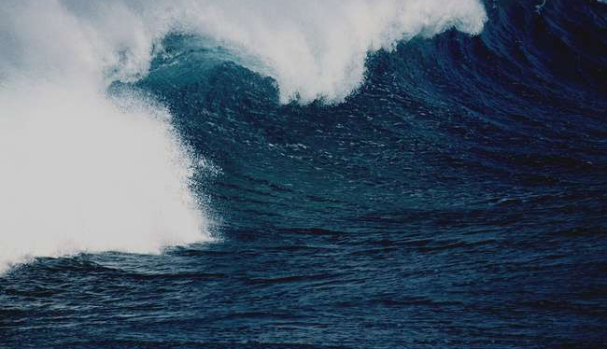
Communication objectives:
Find out the target customer-Teenagers and young adults
Create a clear and understandable encoding massage- CHABAN PANIO
Choose the appropriate media-TV, Facebook,YouTube and other socials
Develop the feedback channels-Added new flavours
Choosing the Appropriate Media:
Facebook
YouTube
Television
Newspaper
Radio
Packaging inserts
Motion pictures
Posters
Pop displays
Logos and videotapes

Slide 23

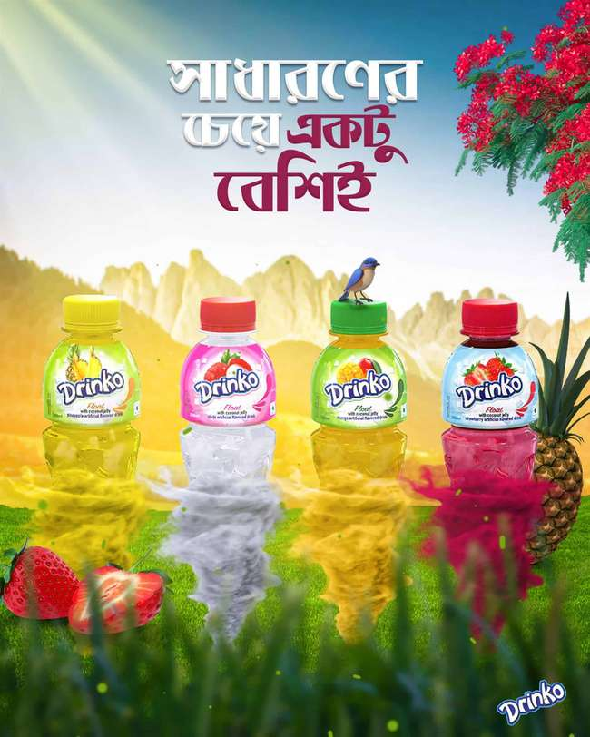
PROMOTIONAL TOOLS

Slide 24
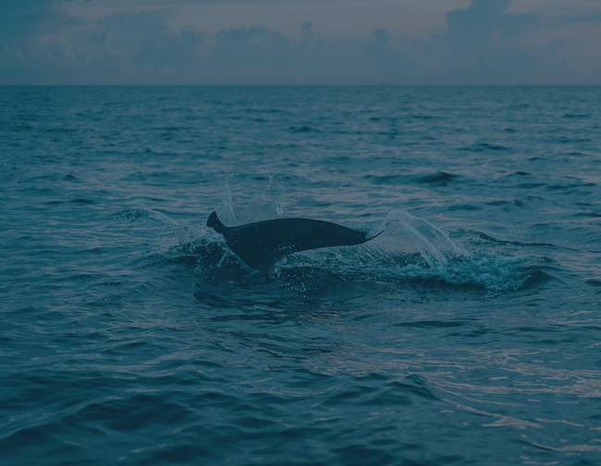

ADVERTISEMENT

Slide 25
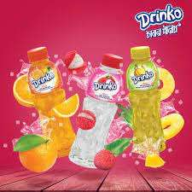
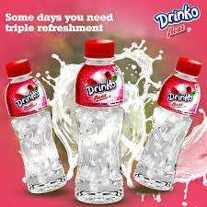
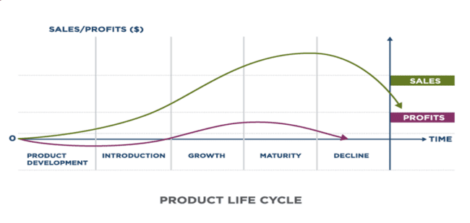
PRODUCT LIFE CYCLE

Slide 26

PRODUCT LIFE CYCLE
GROWTH STRATEGY
Product Line Extensions
Penetration Pricing
DISTRIBUTION

Slide 27
PRODUCT LIFE CYCLE
GROWTH STRATEGY
Advertising
NEW MARKET
SEGMENT
SALES PROMOTION

Slide 28
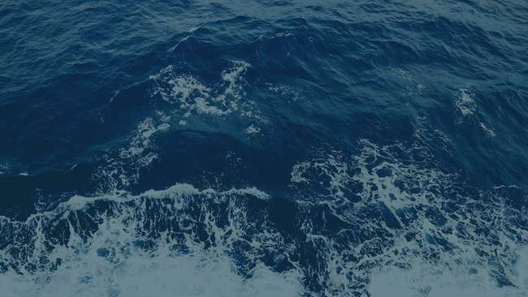
PRODUCT LIFE CYCLE
GROWTH STAGE

Slide 29
CONCLUSION

Slide 30
PRAN Drinko is currently one of the most well-known brands in Bangladesh and the global market.
Drinko is widely consumed by the public for several reasons, which increases consumer demand.
We are so happy to learn that the locally manufactured beverage can now completely cover the demand for PRAN Drinko across the nation.
The effectiveness of PRAN Drinko's current marketing strategy must be strong in order for the company to succeed.
PRAN aims to store Drinko in the majority of the retail space.
As a result, the corporation will need to distribute widely.
Current issues can be resolved by an efficient marketing strategy.
CONCLUSION

Slide 31
THANK YOU

